Slide 1
sizing
Taught by Yossef Ayman Zedan

Slide 2
Width relative to the parent
Width and height utilities are generated from the utility API in _utilities.scss. Includes support for 25%, 50%, 75%, 100%, and auto by default. Modify those values as you need to generate different utilities here.
<div class="w-25 p-3" style="background-color: #eee;">Width 25%</div> <div class="w-50 p-3" style="background-color: #eee;">Width 50%</div> <div class="w-75 p-3" style="background-color: #eee;">Width 75%</div> <div class="w-100 p-3" style="background-color: #eee;">Width 100%</div> <div class="w-auto p-3" style="background-color: #eee;">Width auto</div>

Slide 3
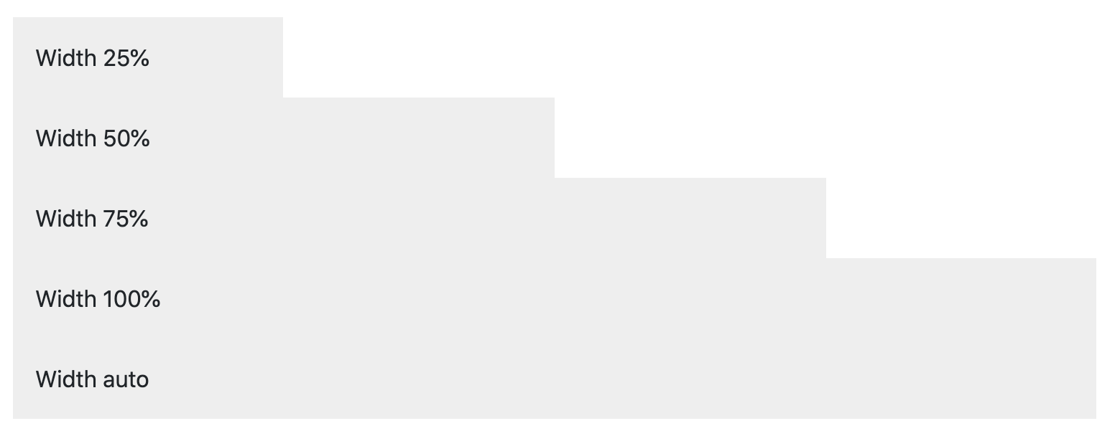
Width relative to the parent

Slide 4
Height relative to the parent
<div style="height: 100px; background-color: rgba(255,0,0,0.1);"> <div class="h-25 d-inline-block" style="width: 120px; background-color: rgba(0,0,255,.1)">Height 25%</div> <div class="h-50 d-inline-block" style="width: 120px; background-color: rgba(0,0,255,.1)">Height 50%</div> <div class="h-75 d-inline-block" style="width: 120px; background-color: rgba(0,0,255,.1)">Height 75%</div> <div class="h-100 d-inline-block" style="width: 120px; background-color: rgba(0,0,255,.1)">Height 100%</div> <div class="h-auto d-inline-block" style="width: 120px; background-color: rgba(0,0,255,.1)">Height auto</div> </div>

Slide 5
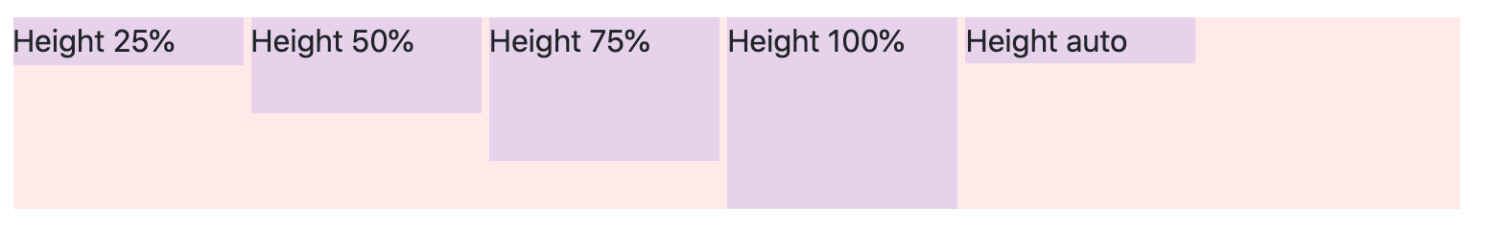
Height relative to the parent

Slide 6

Max width
You can also use max-width: 100%; and max-height: 100%; utilities as needed.
<img src="..." class="mw-100" alt="...">

Slide 7
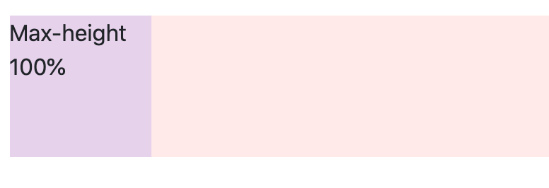
Max height
<div style="height: 100px; background-color: rgba(255,0,0,.1);">
<div class="mh-100" style="width: 100px; height: 200px; background-color: rgba(0,0,255,.1);">
Max-height 100%
</div>
</div>

Slide 8
Relative to the viewport
You can also use utilities to set the width and height relative to the viewport.
<div class="min-vw-100">Min-width 100vw</div> <div class="min-vh-100">Min-height 100vh</div> <div class="vw-100">Width 100vw</div> <div class="vh-100">Height 100vh</div>

